Slide 1
Update 4 & 5
Dev Bhatia
Ultrafast Optics Laboratory
Boston University

Slide 2
Paper Analysis
Ganguly, M., Jenkins, M. W., Chiel, H. J., &amp; Jansen, E. D. (2016). Modeling the effects of elevated temperatures on action potential propagation in unmyelinated axons. Clinical and Translational Neurophotonics; Neural Imaging and Sensing; and Optogenetics and Optical Manipulation. doi:10.1117/12.2211048

Slide 3
Abstract
Model predictions demonstrate that increased temperatures cause disruptions in voltage gated ion channels
A model utilizing the NEURON library was created in order to simulate the behavior of unmyelinated nerve axons with varying temperature distributions
Axon behavior and associated underlying mechanisms are investigated

Slide 4


Modeling Methodology – Equations
Overall Conductance for Potassium Channels
n = the probability that a potassium gating element will move into a conducting state
Overall Conductance for Sodium Channels
m = the probability that a sodium gating element will move into a conducting state
h = probability that another gating element is initially open at rest then closes

Slide 5
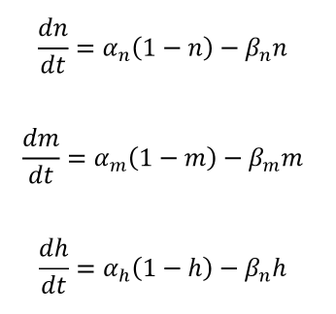
Modeling Methodology - Equations
Rate of change in the probability in the probability of the gates conducting –
α = the rate at which a gate that is currently not conducting would become conducting
β = the rate at which a gate that is currently conducting would become non conducting
α, β are functions of the membrane voltage Vm

Slide 6


Modeling Methodology – Equations
x = m, n, or h
n = simultaneous activating of 4 gating elements
m = simultaneous activating of 3 gating elements
h = probability of a gating element open at rest, but closes with a probability
k = thermic coefficient
T = experimental temperature
To = Baseline Temperature
ai(i = m,n,h) & bi(i = m,n,h) = Functions of the membrane voltage

Slide 7
Modeling Methodology - Environment
NEURON contains several built-in functions that allow for simple solving of the differential equations involved in the H-H mechanism
Imported libraries include Numpy and Matplotlib

Slide 8
Modeling Methodology - Geometry
The model used assumes a 40mm x .5mm one-dimensional axon
This axon is divided into 999 segments, with the membrane voltage, gating variables, and ionic currents calculated at each node
The NEURON Iclamp function is used to deliver electrode current into the cell
Current is measured from the middle of the 40mm axon, stimulated with 2000 nA

Slide 9
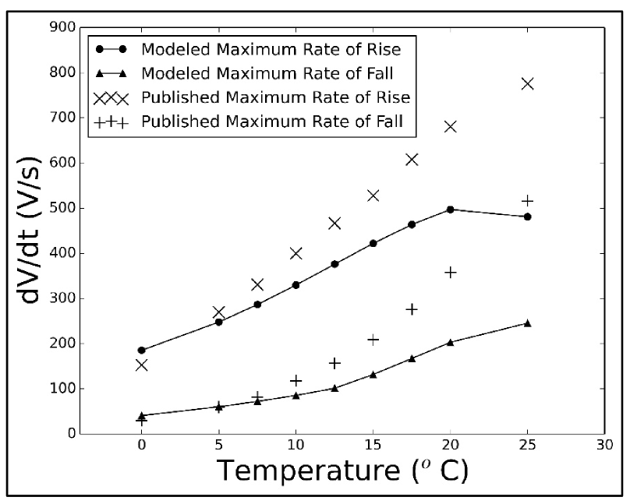
Results – Model Validation
The modeling and published experimental data show good agreement at low temperatures, but show large deviations at higher temperatures
**The x-axis is the temperature delta

Slide 10
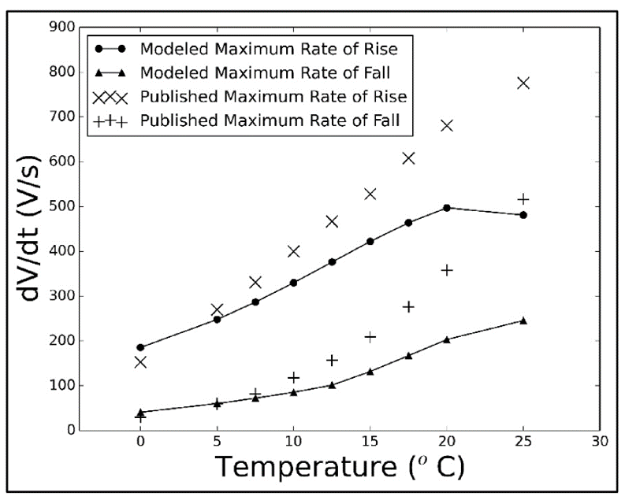
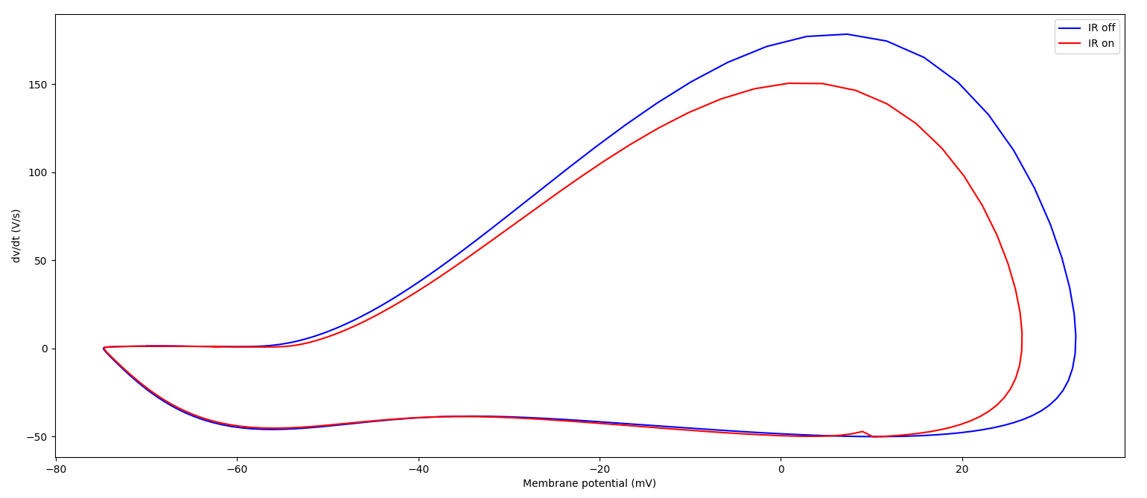
Conclusion

Slide 11
Conclusion
Traces of this paper can be found in certain pieces of the written code
It will be further elucidated with the following paper – this was the proceedings paper
This model can be utilized for our purposes – the geometry is indicative of such

Slide 12
Next Steps
Read the full paper
Continue to search the code for implementation strategies
Further develop my temperature model

